Slide 1

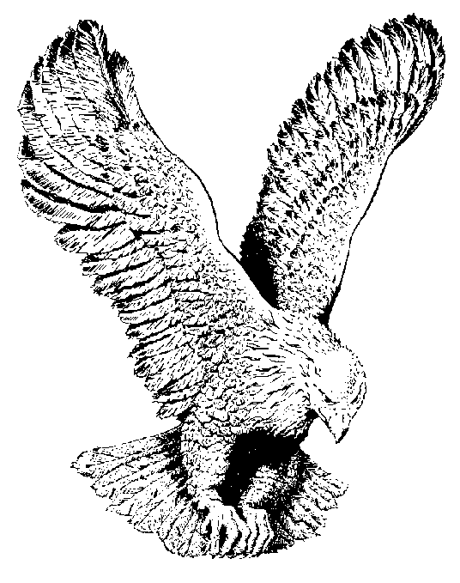
73
I’M OVERCOMING
I’m overcoming, I’m overcoming,
I’m overcoming, I’m overcoming,
For I love Jesus, He’s my Saviour,
And He smiles and He loves me too.

